Slide 1

Sprocket Central Pty Ltd
Data analytics approach
Sneha Chavakula

Slide 2
Agenda
Introduction
Data Exploration
Model Development
Interpretation

Slide 3
Introduction
Identify and Recommend Top 1000 Valuable Customers
Outline of Problem
Sprocket Central Pty Ltd is a long-standing KPMG client specializing in high-quality bikes and cycling accessories.
The marketing team aims to enhance business by examining existing customer data to identify customer behavior and trends.
The goal is to determine which of the 1000 new customers should be targeted for maximum value for the company.
The analysis will use three labeled datasets: customer demographic, customer address, and transactional data.
Approach
RFM analysis and customer classification
Wealth segmentation by age category
Top industries contributing to profit
New and Old customer age distributions
Bike related purchases over the last three years by gender
Job industry distribution
Number of cars owned in each state

Slide 4
Data Exploration
Data Quality Assessment
The following are the key issues addressed when dealing with data quality problems:
 | Accuracy | Completeness | Consistency | Relevancy | Validity
Customer Demographic | DOB : Inaccurate Age : Missing | Job title : Blanks Last name : Blanks | Gender : Inconsistent | Default : Delete
Customer Address |  |  | State : Inconsistent
Transactions | Profit : Missing | Order status : Blanks Brand : Blanks |  | Cancelled Status Order : Filtered out | List price : Format Product first sold date : Format

Slide 5
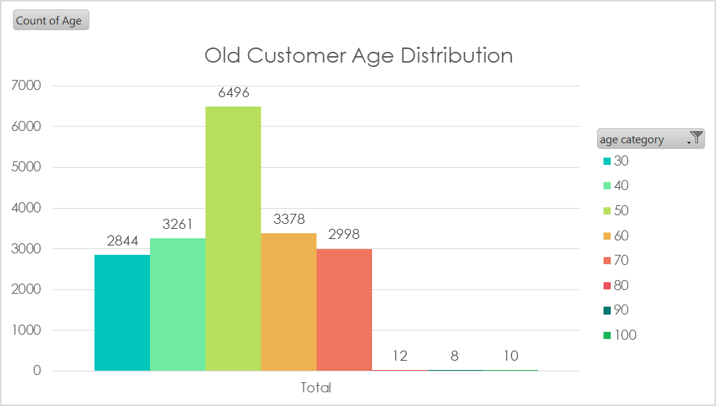
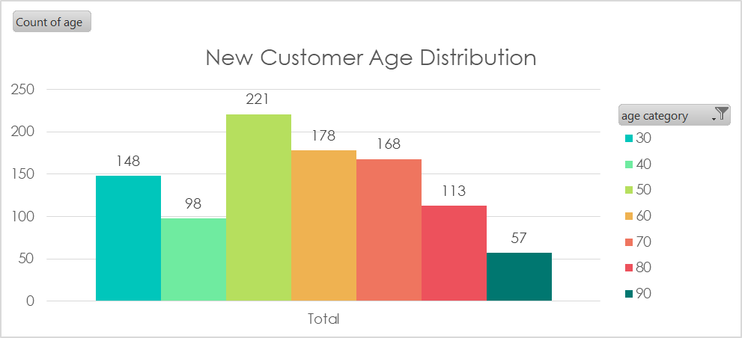
Data Exploration
New and Old Customers Age Distributions
Most customers are aged between 50 – 59 in 'New' as well as 'Old' customers.
The lowest no of customers are present in the age group of 90 – 99 in both new as well as old customer list.
The old customer list suggests that the highest count of customers are present in the middle aged categories(age groups of 40 – 69) and the older age categories(70-100) have a relatively lower count of customers compared to the middle-aged population.
Whereas the new customer list suggests that the highest count of customers are in the 50-59 and 60-69 age groups and the younger age categories (30-39) have a relatively lower count of customers

Slide 6
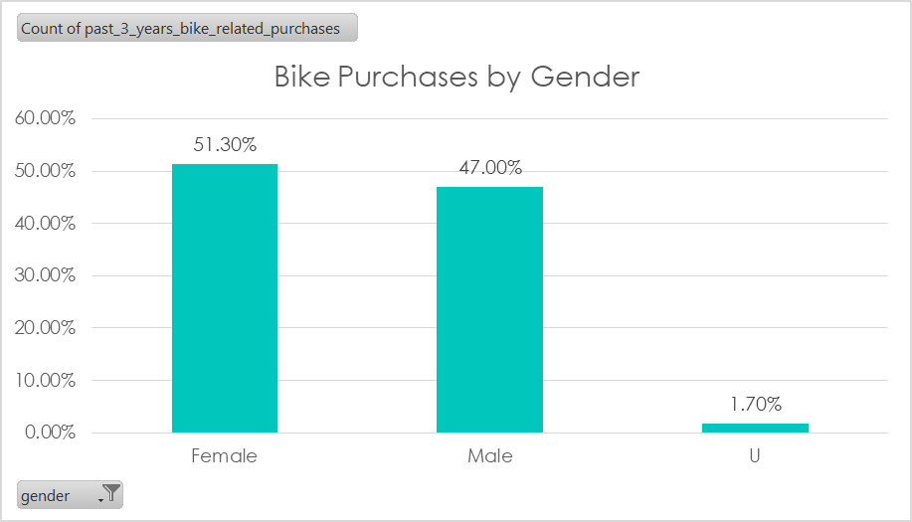
Data Exploration
Bike Related Purchases Over the Last 3 Years by Gender
The data shows that females account for 51.30% of past 3 years bike-related purchases, while males account for 47.00%. And 1.07% were made by unspecified gender.
On an average females have had 4.3% higher bike related purchases compared to men in the last 3 years.

Slide 7
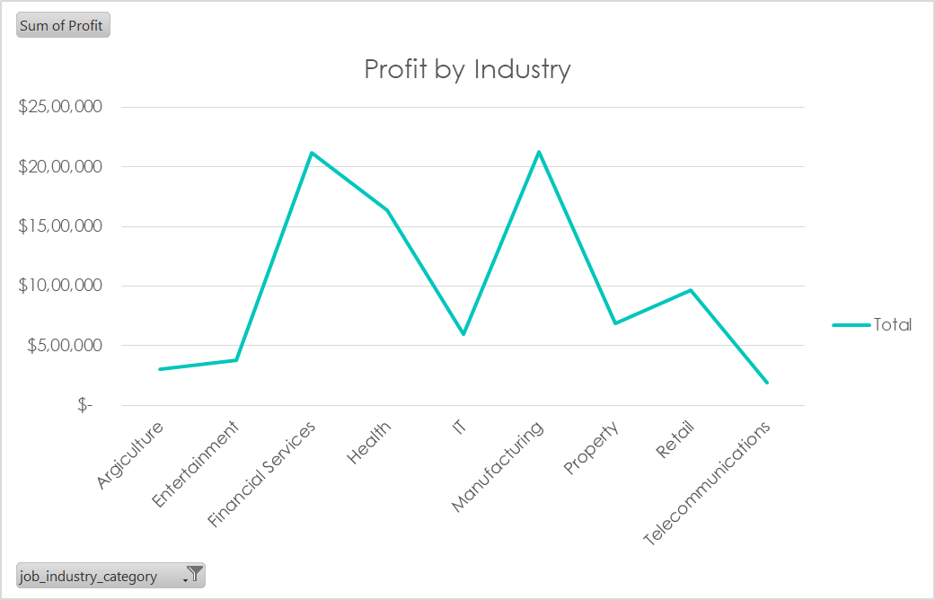
Data Exploration
Profit Distribution by Job Industry
Top 3 highest profit bringing industries are : Financial services, Health and Manufacturing
On the other hand, the Telecommunications industry contributed the lowest amount of profit, with only $1,86,662.
The majority of the industries have generated profits that are below $1,000,000.

Slide 8
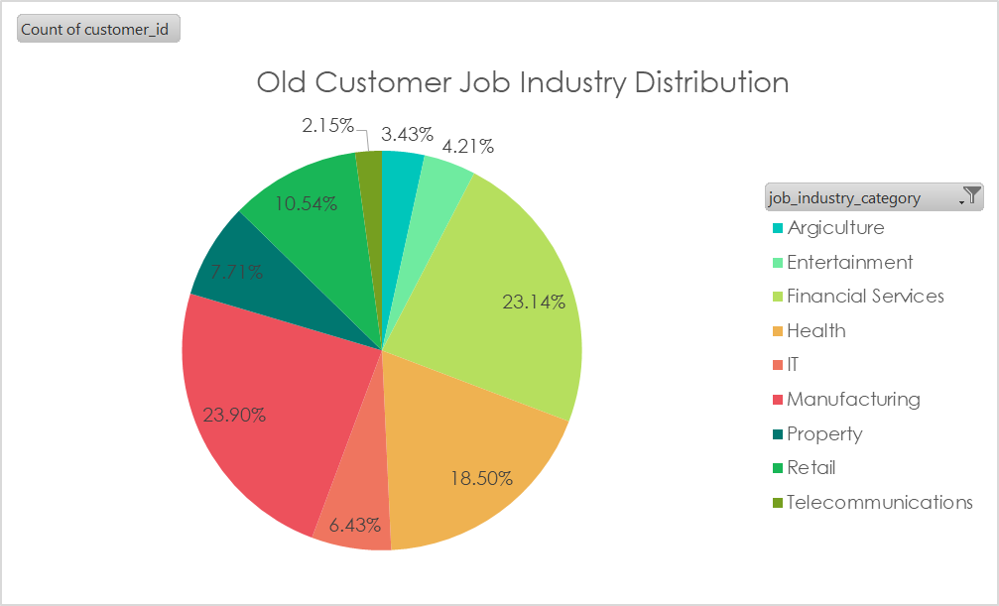
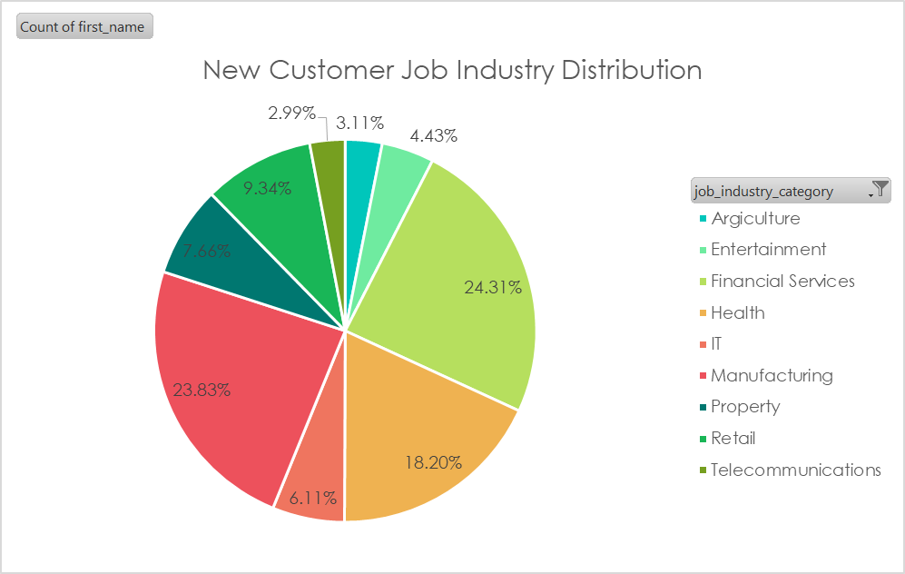
Data Exploration
Job Industry Distribution
23% of old customers are in Manufacturing and Financial services.
The smallest number of customers are in Agriculture and Telecommunications.
24% of new customers are from Financial services and 23% are from Manufacturing

Slide 9
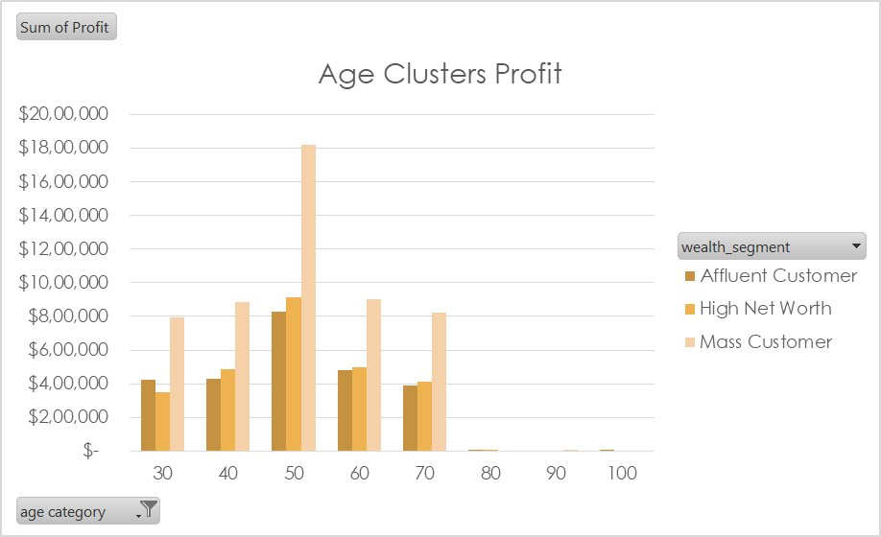
Data Exploration
Profit Of Wealth Segment by Age Category
'Mass Customer' segmentation makes highest profit over all the age categories.
The next highest category is the 'High Net Worth' segmentation.
The buying power increases steadily over all the categories up till 59 and then sees a decline in buying power, thus leading to lower profits.

Slide 10
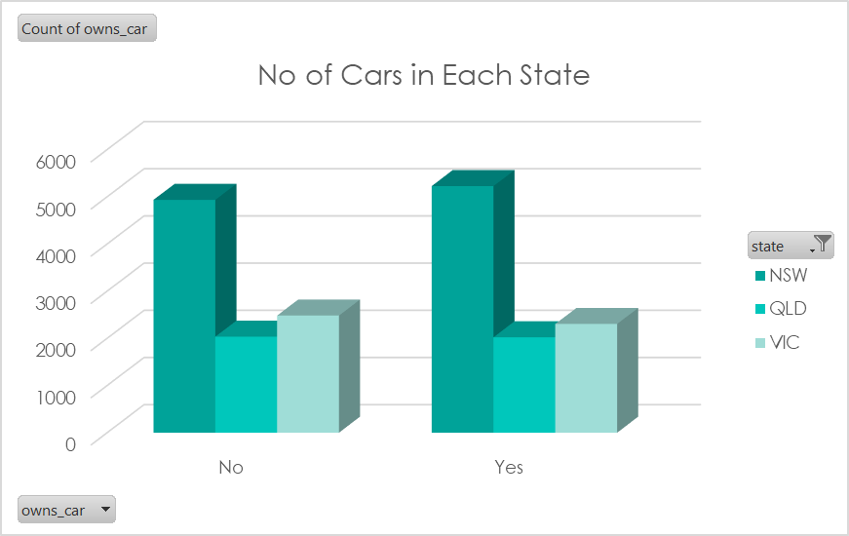
Data Exploration
Number of Cars Owned and Not Owned by State
NSW has the largest number of people that owns as well as don’t own a car. Thus, it has high potential to find value customers.
Cars owned and not owned are split quiet evenly across all the states.

Slide 11
Model Development
RFM Analysis
RFM is then used to identify a company’s or an organization’s best customers by measuring and analyzing spending habits to improve low-scoring customers and maintain high-scoring ones.
It segments customers based on their behavior, specifically their recency, frequency, and monetary value of purchases.
The resulting RFM segments can be used to develop personalized marketing campaigns, such as offering discounts to customers who haven't made a purchase in a while, or providing exclusive offers to high-value customers.
The RFM model assigns a score of 1 to 4 (from worst to best) for customers in each of the three categories.

Slide 12
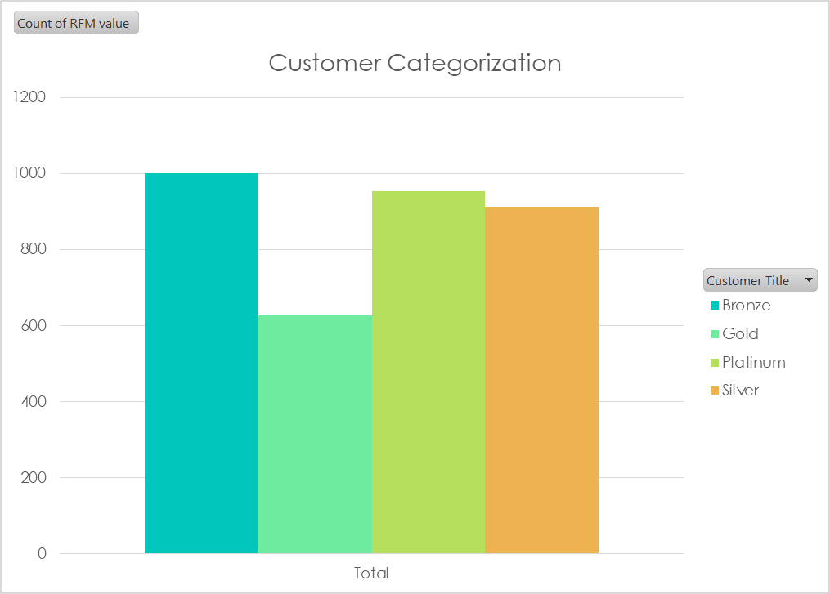
Model Development
Customer Segmentation Using RFM Analysis
First, calculated the Min, lower quantile, median, upper quantile and max for Recency, Frequency and Monetary.
Then, calculated RFM value using R score, F score and M score.
And then using the RFM value segmented the customers into 'Platinum', 'Gold', 'Silver' and 'Bronze'.

Slide 13
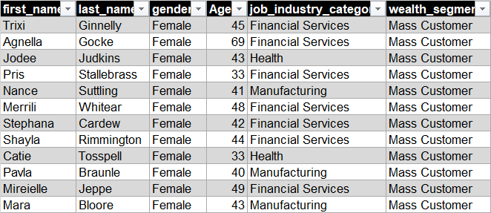
Interpretation
Summary Table of Top 1000 Customers
Filtered out the data based on conclusions drawn from data exploration.
These are the customers that are from the highest profit making industries and wealth segments.

